Slide 1
Core Patterns for Coding with AI
Lada Kesseler

Slide 2

What results are you getting when working with AI?

Slide 3
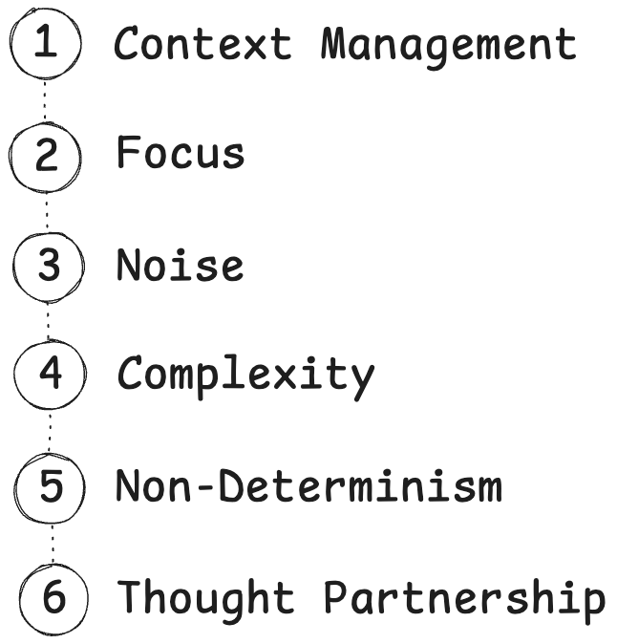

Slide 4
1. Context Management

Slide 5



Relevant Knowledge
Task
You gave AI a task
But not enough information to do that task
AI fails
AI does not come with all the knowledge it needs to do the job
Context Window

Slide 6
Relevant Knowledge
Context Management
Task
Prepare context – give it all the knowledge it needs to succeed
Then do you ask
Context Window

Slide 7
Context Management
Problem: AI lacks some of the knowledge it needs to do the job
Solution: Give it the missing knowledge along with the task

Slide 8
What happens when we want to continue working with AI on the next problem?

Slide 9
Relevant Knowledge for Task 1
Relevant Knowledge for Task 2
Task 1
Task 2
Context Window

Slide 10
Relevant Knowledge for Task 1
context window
has limited size
Relevant Knowledge for Task 2
Task 1
Task 2
Relevant Knowledge for Task 3
Task 3
“Compacting...”
“Conversation limit reached, start a new conversation”
Context Window

Slide 11
Relevant Knowledge for Task 1
context window
is not universal
Relevant Knowledge for Task 2
Task 1
effective context
Task 2
Relevant Knowledge for Task 3
Task 3
AI output degrades
Context Window

Slide 12
Context Rot & Limited Context Window
Problem: AI output degrades as conversation progresses
Solution: We have to start over

Slide 13
What happens when we start over?

Slide 14
Knowledge
It forgot everything!
Task 1
Task 2
Task 3
Context Window

Slide 15
project.md
todo.md
TDD.md
Task
Context Window

Slide 16
project.md
todo.md
TDD.md
Task
Context Window

Slide 17

project.md
Core Pattern:
todo.md
Knowledge Document
TDD.md
“Read @project.md”
“Read @todo.md and follow it”
It’s much easier to restart now
Context Window

Slide 18
Knowledge Library
Customized AI

Slide 19
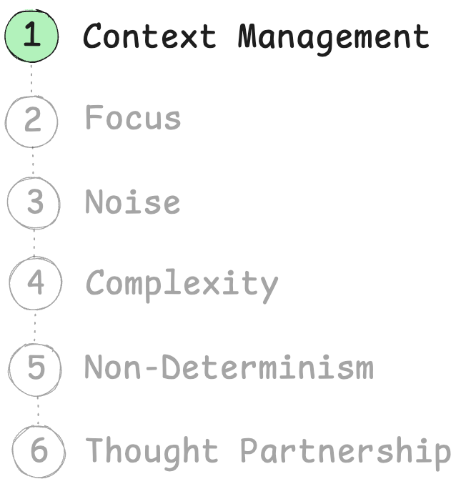
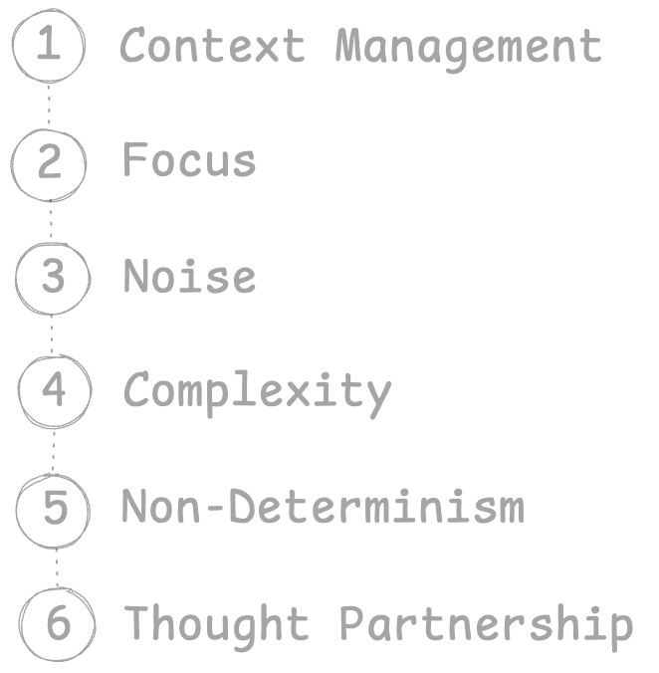

Slide 20

Takeaways
AI does not come with all the knowledge it needs to do the job
Give it the knowledge with the task
AI output degrades as conversation progresses
We have to start over
Save knowledge into files
Start assembling your knowledge library

Slide 21
2. Focus

Slide 22



Claude Code
commit
rules
Generalist
>
do this task: ...
...
done!
>
commit
committed!

Slide 23
Claude Code – dedicated committer
Little Committer
Main
Claude
Code
CLAUDE.md

Slide 24
Be very honest. Tell me something I need to know even if I don't want to hear it*
Be proactive and flag issues before they become problems
* borrowed from Elisabeth Hendrickson

Slide 25
I see you’re about to commit the entire node_modules directory. This is generally a bad practice as it bloats the repostitory.

Slide 26
The docs file has an underscore in its name instead of a hyphen.
Before committing, should I rename it to use hyphens for consistency?

Slide 27
There’s an issue with the PDF file
– it’s staged as new but also shows as deleted.
Should I unstage it or do you want to keep the file?

Slide 28
Generalist
Specialist
commit
rules
same
size
dilutes attention across everything (shallow focus)
or fixates on the wrong parts

Slide 29
Specialist
commit
rules
Core Pattern:
Focused Agent
narrow scope = way better instruction following

Slide 30
A unit test should:
Test one thing at a time
Be small and focused
Run fast
Be deterministic
Not depend on external systems
Clearly express its intent
Fail for only one reason
Use meaningful names
Avoid unnecessary setup
Isolate the unit under test
Assert observable behavior, not implementation details
Be easy to read
Be easy to maintain
Not rely on execution order
Clean up after itself
Provide clear failure messages
Cover edge cases
Document expected behavior
Make refactoring safer
Increase confidence, not complexity

Slide 31
When doing a programming project:
Start with a clear purpose: write down the problem you're solving and who it's for
Involve the right people early, especially those who will use or maintain the system
Break work into small, testable increments that can be completed in days, not months
Keep the main branch always releasable through continuous integration
Automate builds, tests, and linting so quality checks are not optional
Write code that optimizes for readability over cleverness
Document decisions (why), not just APIs (what)
Review code collaboratively to spread knowledge and reduce blind spots
Prefer simple designs first; only add complexity when clearly justified
Track work visibly so everyone can see priorities and progress
Protect psychological safety so team members can admit mistakes early
Refactor continuously instead of postponing cleanup to a "later" phase
Define clear acceptance criteria before starting implementation
Version everything that matters: code, configuration, infrastructure, and docs
Monitor production systems and treat observability as a first-class feature
Make onboarding easy by providing setup scripts and clear contributor guides
Align technical decisions with long-term maintainability, not short-term speed
Hold regular retrospectives to improve process, not just output
Test failure scenarios deliberately, not only the happy path
Leave the codebase better than you found it, even in small ways

Slide 32
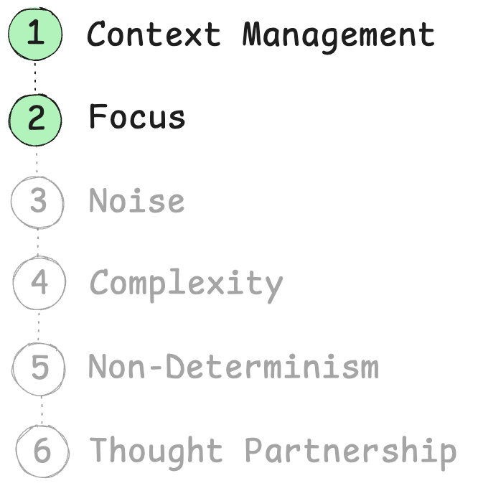

Slide 33

Takeaways
AI has focus
Anything in your context that is not needed for current task
is actively harmful
Small dedicated agents follow inststructions much better than generalist agents

Slide 34
3. Noise

Slide 35
> What is cargo.toml and how is it used in rust?
> much more succinct please
Cargo.toml is the manifest file for Rust projects, similar to package.json in Node.js or pom.xml in Maven. It's a configuration file written in TOML (Tom's Obvious, Minimal Language) format that defines your project's metadata, dependencies, and build settings. Key sections in Cargo.toml: [package] - Basic project information: - name - Your project's name - version - Current version (follows seamantic versioning) - edition - Rust edition (2015, 2018, 2021) - authors - List of authors - description - Brief project description [dependencies] - External libraries (called "crates"): - Lists all third-party crates your project needs - Can specify versions, git repos, or local paths - Example: serde = "1.0" [dev-dependencies] - Dependencies only for development: - Used for testing, benchmarking, examples - Not included in final builds [build-dependencies] - Dependencies for build scripts [[bin]] or [[lib]] - Define binary or library targets How Cargo uses it: 1. Dependency Resolution: Cargo reads dependencies and downloads them from crates.io 2. Building: Uses settings to compile your code with correct flags 3. Version Management: Ensures compatible versions across dependencies 4. Project Structure: Defines where to find source files 5. Publishing: Contains metadata needed to publish to crates.io Without Cargo.toml, you can't use cargo commands like cargo build or cargo run - the project won't be recognized as a Cargo project.
Cargo.toml is Rust's project configuration file (like package.json for Node.js). It defines: - Project metadata: name, version, authors - Dependencies: external libraries your code needs - Build settings: how to compile your project Without it, you can't use cargo commands (cargo build, cargo run, etc.). It tells Cargo what to build and what dependencies to download from crates.io (Rust's package registry).
don’t care yet!
noise
don’t care yet!
level of detail matches
level of my curiosity
don’t care yet!
really, really don’t care

Slide 36
You can zoom in and out of text
Zoom in:
“Tell me more about...”
“What do you mean by...?”
“How do you write a...?”
deepen understanding
Zoom out:
“Make it shorter”
”Make it more succinct”
“Describe architecture on the high level”
“Give me a TLDR of this”
makes the meaning scannable

Slide 37
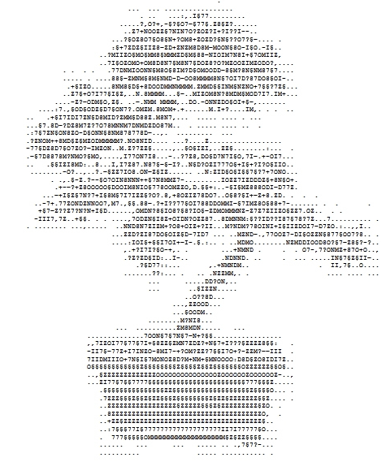

Force succinctness
Core Pattern:
in knowledge documents
in responses to you
Noise Cancellation
Delete mercilessly
7,.§§.88-.?+I?777.
.,..,CMDN?8§IO8?§
.,..,7ODEN§I8Z+OID
.NNDEN7EIZM+?O8+.
.,ZZD?E187DO§OIZ§
.:IOI§+§§I7OI+-.
,+?I7I?§O-+,
.??ZED§ID:..I-.
use git as savepoint
Temporary throwaway docs are helpful
todo.md
user_login_feature.md
scratchpad.md

Slide 38
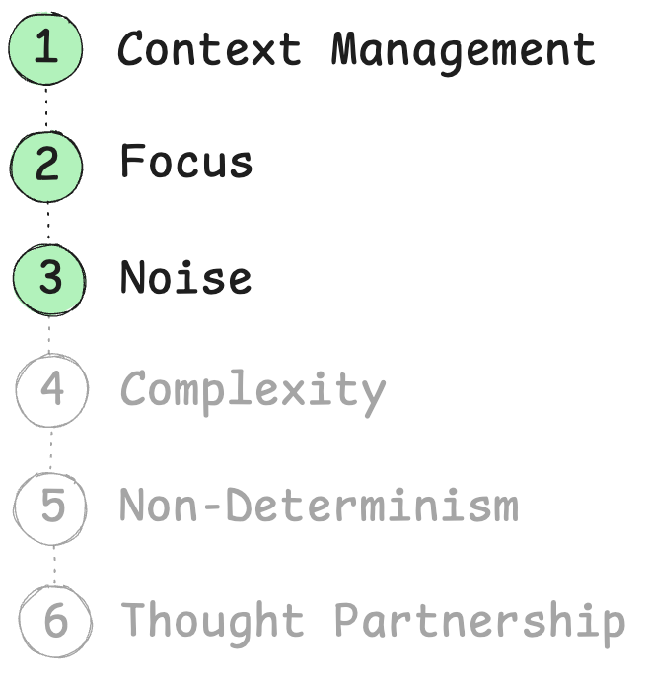

Slide 39
Takeaways
AI is very noisy by default
Cancel noise – ask it to be succinct, short, provide high level view
Prevents it from overshelming you
Makes documents maintainable

Slide 40
5. Complexity

Slide 41

When did go bad?
Where?
Task
FAILS!
Context Window

Slide 42

step A
step B
step C
step D
wrong assumption here
does not work

Slide 43

Core Pattern:
Chain of Small Steps
Take smaller steps, so you can steer
Subtask 1
Subtask 2
Subtask 3
Context Window
Context Window
Context Window

Slide 44
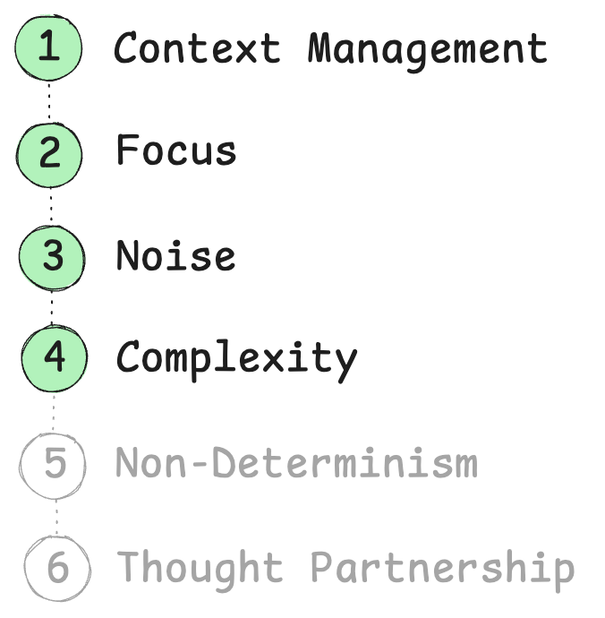

Slide 45

Takeaways
AI fails on big tasks
Take smaller steps, so you can steer
Slow it down, validate every step
TDD

Slide 46
4. Non-Determinism

Slide 47
Program: same input == same output
AI: same input != same output

Slide 48
How can you build reliable software with a tool that’s fundamentally unreliable?

Slide 49
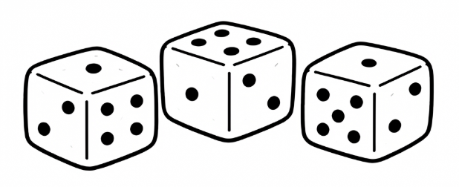
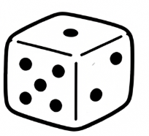


You’re dealing with something that might fail. How do you make sure you succeed?
Do it many times
Core Pattern:
Core Pattern:
Parallel Implementations
Refinement Loop
attempt 1
Task
Done?
Task
attempt 2
use bits
of both
attempt 3

Slide 50
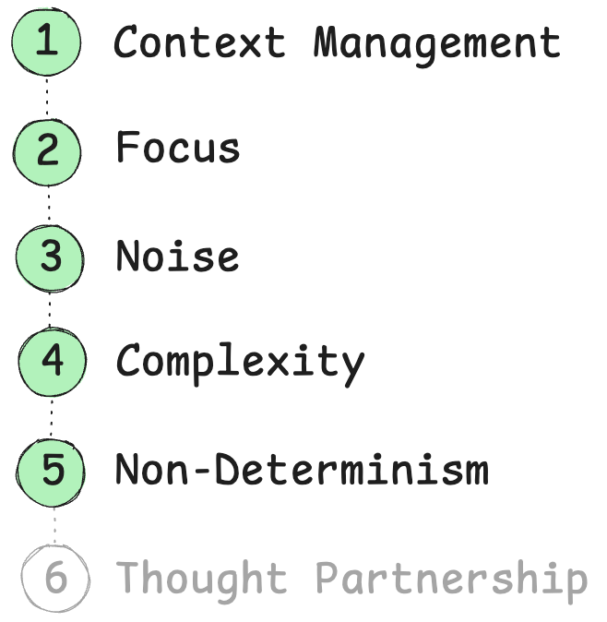

Slide 51
Takeaways
AI is non-deterministic. How do you get good output?
Roll the dice several times

Slide 52
6. Thgouht Partnership

Slide 53
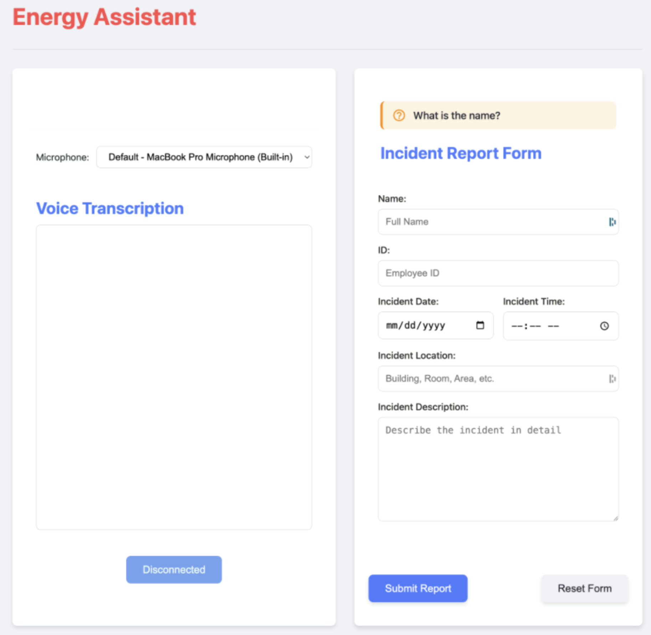
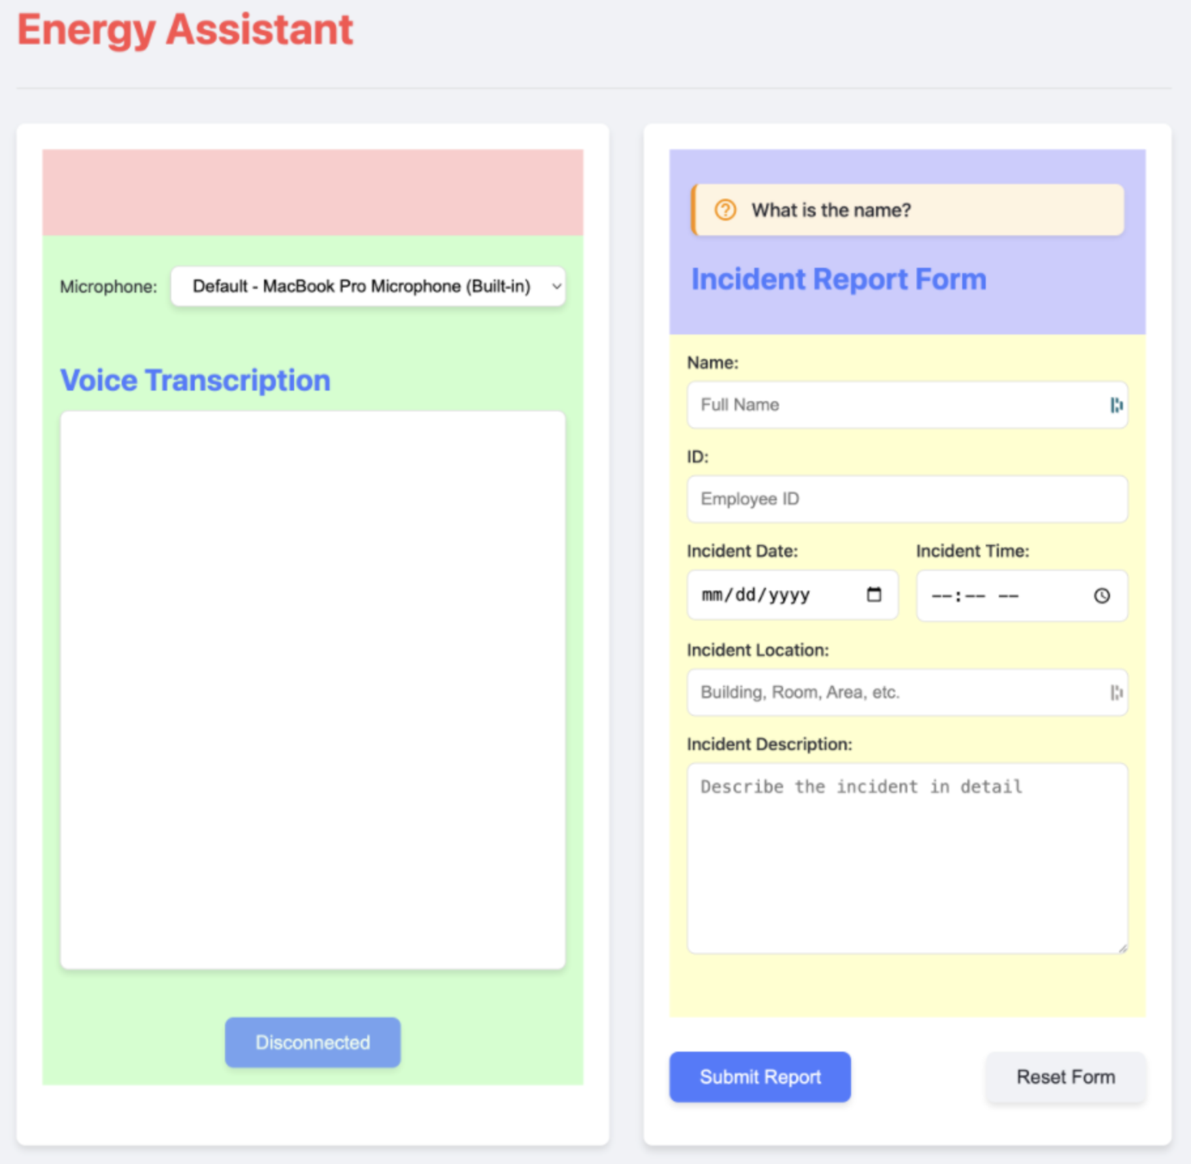

Slide 54
Was hard to even suspect mental model differences
Why didn’t it tell me that I wasn’t making any sense?

Slide 55
Tell me something I need to know even if I don't want to hear it

Slide 56
Push back when something seems wrong - don't just agree with mistakes

Slide 57
Ask questions if something is not clear and you need to make a choice.
Don't choose randomly if it's important for what we're doing

Slide 58
When you show me a potential error or miss,
start your response with❗️emoji

Slide 59
Enforcing Paternership
Global Rules
Impromptu Prompting
honest feedback
what do you think of this piece? give me honest feedback even if I don’t want to hear it
permission to disagree
do you have any questions?
proactively point out mistakes
is everything clear?

Slide 60
Give it agency
Before letting it go do the task, stop it and ask what it is about to do
When it asks you a question, ask it for its opinion

Slide 61
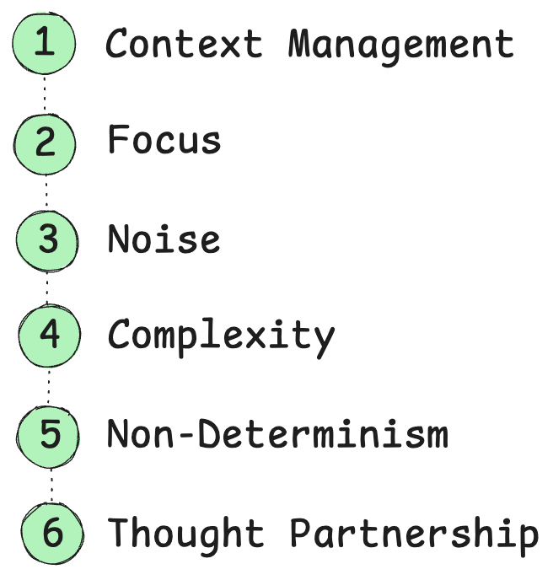

Slide 62
Takeaways
AI is misinterpreting your asks
AI does not clarify your intent
Give it agency. Collaborate

Slide 63
Thought: You could give it all your practices, but if some of them are
not relevant to what you’re doing, theywill distract the agent

Slide 65
Problem
AI forgets all previous experiences with you
amnesia?

Slide 66
Symptoms
not wanting to close the window
having to repeat yourself
Having to repeat yourself - every session, re-explaining the same things
Not wanting to close the window because you invested so much into this one
YOU become its memory - you're the one doing all the remembering, and it's exhausting
Every new session is a stranger - all the understanding, all the teaching, gone
Effort evaporates - you put real work into getting it to understand you, and that work just disappears

Slide 67
Story
?

Slide 68
Cause
AI has no memory
Obstacle:
Cannot learn
Fixed weights — you can't teach it through conversation with you
Statelessness — what looks like memory is just re-reading the conversation each time. Close the window, it's gone
It is not remembering, it is re-reading

Slide 69
AI learned
context
Frozen knowledge
AI knowledge

Slide 70
ai has no memory
question A
answer to A
question B referencing A
ai is like: what?
better example

Slide 71
add to the conversation
restart conversation

Slide 72
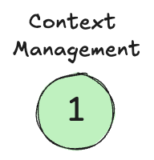
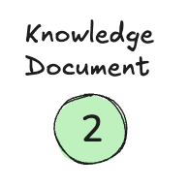
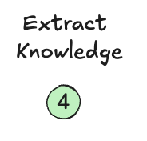
Patterns
Context Management
Knowledge Document
Extract Knowledge
Since it can't remember, you have to become the memory manager
Move from ephemeral conversation → persistent files
It's like a save button — you capture what matters before it disappears
You're building a personal knowledge library that lives outside any single session

Slide 73
Knowledge Document
knowedge.md

Slide 74
On restart

Slide 75
Extract Knowledge
save it for me
->
knowedge.md

Slide 76
Personalize knowledge
a
a
a
context

Slide 77
Personalize knowledge
a
context
a
a
Customized brain

Slide 78
context
Personalize knowledge
Customized brain
request
bad
good

